Slide 1
Index Construction

Slide 2
Inverted Index Revision
Document1:
I did enact Julius Caeser. I was killed i’ the capitol; Brutus killed me
Document2:
so let it be with Caeser. The noble Brutus hath hold you Caeser was ambitious

Slide 3
Tokenization
Caeser | 1
I | 1
Did | 1
Enact | 1
Julius | 1
Caeser | 1
I | 1
Was | 1
Killed | 1
i’ | 1
The | 1
Capitol | 1
Brutus | 1
Killed | 1
Me | 1
So | 2
Let | 2
It | 2
Be | 2
with | 2
Caeser | 2
Task
Chop document into pieces
Throw away characters such as punctuations
Example1:
Document1:
I did enact Julius Caeser. I was killed i’ the capitol; Brutus killed me
Document2:
so let it be with Caeser. The noble Brutus hath hold you Caeser was ambitious
The | 2
Noble | 2
Brutus | 2
Hath | 2
Hold | 2
You | 2
Caeser | 2
Was | 2
Ambitious | 2

Slide 4
Sorting
Caeser | 1
I | 1
Did | 1
Enact | 1
Julius | 1
Caeser | 1
I | 1
Was | 1
Killed | 1
i’ | 1
The | 1
Capitol | 1
Brutus | 1
Killed | 1
Me | 1
So | 2
Let | 2
It | 2
Be | 2
with | 2
Caeser | 2
Term | DocID
ambitious | 2
Be | 1
Brutus | 1
Brutus | 2
Capitol | 1
Caeser | 1
Caeser | 2
Caeser | 2
Did | 1
Enact | 1
Hath | 1
I | 1
I | 1
i’ | 1
It | 2
Julius | 1
Killed | 1
Killed | 1
Let | 2
Term | DocID
Me | 1
Noble | 2
So | 2
The | 1
The | 2
Told | 2
You | 2
Was | 1
Was | 2
With | 2
The | 2
Noble | 2
Brutus | 2
Hath | 2
Hold | 2
You | 2
Caeser | 2
Was | 2
Ambitious | 2

Slide 5
Inverted index: Dictionary & Postings
Multiple term entries in a single document are merged
Split into dictionary and postings

Slide 6
Term | DocID
ambitious | 2
Be | 1
Brutus | 1
Brutus | 2
Capitol | 1
Caeser | 1
Caeser | 2
Caeser | 2
Did | 1
Enact | 1
Hath | 1
I | 1
I | 1
i’ | 1
It | 2
Julius | 1
Killed | 1
Killed | 1
Let | 2
Term | Doc freq
ambitious | 1
Be | 1
Brutus | 2
Capitol | 1
Caeser | 2
Did | 1
Enact | 1
Hath | 1
I | 2
i’ | 1
It | 1
Julius | 1
Killed | 1
Let | 1
Me | 1
Noble | 1
So | 1
The | 2
Told | 1
You | 1
Was | 2
With | 1
Posting List
2
2
1
2
1
1
2
1
1
Term | DocID
Me | 1
Noble | 2
So | 2
The | 1
The | 2
Told | 2
You | 2
Was | 1
Was | 2
With | 2
2
1
2
1
1
2
1
1
1
1
2
2
2
1
2
2

Slide 7
Construction
How do we construct an index?
What strategies can we use with limited main memory?

Slide 8
Hardware basics
Many design decisions in information retrieval are based on the characteristics of hardware

Slide 9
Hardware basics
Access to data in memory is much faster than access to data on disk
Disk seeks: No data is transferred from disk while the disk head is being positioned
Therefore, transferring one large chunk of data from disk to memory is faster than transferring many small chunks
Disk I/O is block-based: Reading and writing of entire blocks (as opposed to smaller chunks)
Block sizes: 8KB to 256 KB.

Slide 10
Hardware basics
Servers used in IR systems now typically have several GB of main memory, sometimes tens of GB
Available disk space is several (2–3) orders of magnitude larger
Fault tolerance is very expensive: It’s much cheaper to use many regular machines rather than one fault tolerant machine

Slide 11
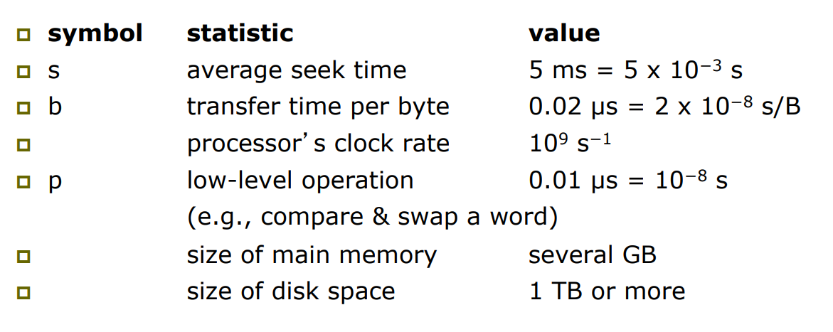
Hardware assumptions

Slide 12
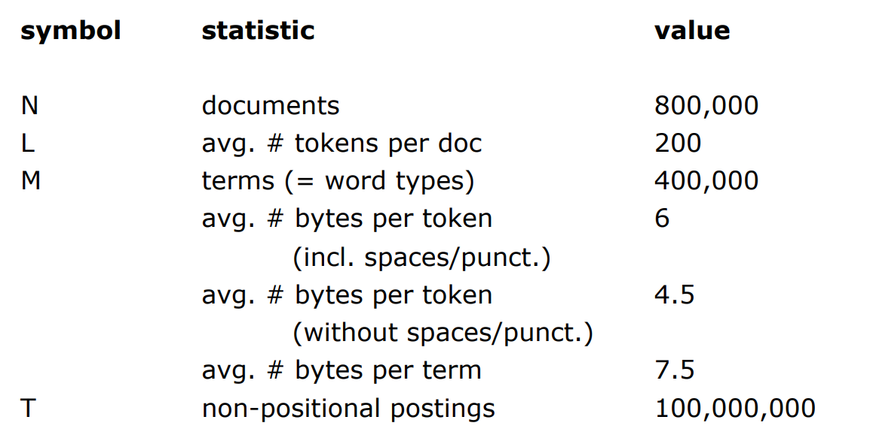
Reuters RCV1 Statistics

Slide 13
Scaling index construction
In-memory index construction does not scale
How can we construct an index for very large collections?
Taking into account the hardware constraints
Memory, disk, speed, etc.

Slide 14
Sort-based index construction
As we build the index, we parse docs one at a time4
The final postings for any term are incomplete until the end
At 12 bytes per non-positional postings entry (term, doc, freq), demands a lot of space for large collections
T = 100,000,000 in the case of RCV1 – so 1.2GB
So … we can do this in memory in 2015, but typical collections are much larger - e.g. the New York Times provides an index of >150 years of newswire
Thus: We need to store intermediate results on disk.

Slide 15
Use the same algorithm for disk?
Can we use the same index construction algorithm for larger collections, but by using disk instead of memory?
i.e. scan the documents, and for each term write the corresponding posting (term, doc, freq) on a file
Finally sort the postings and build the postings lists for all the terms
No: Sorting T = 100,000,000 records (term, doc, freq) on disk is too slow – too many disk seeks
We need an external sorting algorithm.

Slide 16
BSBI: Blocked sort-based Indexing (Sorting with fewer disk seeks)
8-byte records (termID, docID)
These are generated as we parse docs
Must now sort 100M such 8-byte records by termID
Define a Block ~ 10M such records
Can easily fit a couple into memory
Will have 10 such blocks to start with
Basic idea of algorithm:
Accumulate postings for each block, sort, write to disk
Then merge the blocks into one long sorted order

Slide 17
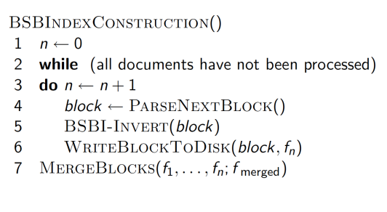
Algorithm

Slide 18
Sorting 10 blocks of 10M records
First, read each block and sort within:
Quicksort takes O(N ln N) expected steps
In our case N=10M
10 times this estimate – gives us 10 sorted runs of 10M records each.
Done straightforwardly, need 2 copies of data on disk
But can optimize this

Slide 19
How to merge the sorted runs?
Can do binary merges, with a merge tree of log210 = 4 layers.
During each layer, read into memory runs in blocks of 10M, merge, write back.
Brutus | D1,D3,D6, D7,
Caeser | D1,D2,D3,D8,D9
Julius | D10
Killed | D8
Noble | D5
With | D1,D2,D3,D5
Brutus | D1, D3,
Caeser | D1,D2,D3
Noble | D5
With | D1,D2,D3,D5
Brutus | D6, D7,
Caeser | D8,D9
Julius | D10
Killed | D8
Posting List to be merged
Disk
Merged Posting List

Slide 20
How to merge the sorted runs?
But it is more efficient to do a multi-way merge, where you are reading from all blocks simultaneously
Open all block files simultaneously and maintain a read buffer for each one and a write buffer for the output file
In each iteration, pick the lowest termID that hasn’t been processed using a priority queue
Merge all postings- lists for that termID and write it out
Providing you read decent-sized chunks of each block into memory and then write out a decent-sized output chunk, then you’re not killed by disk seeks

Slide 21
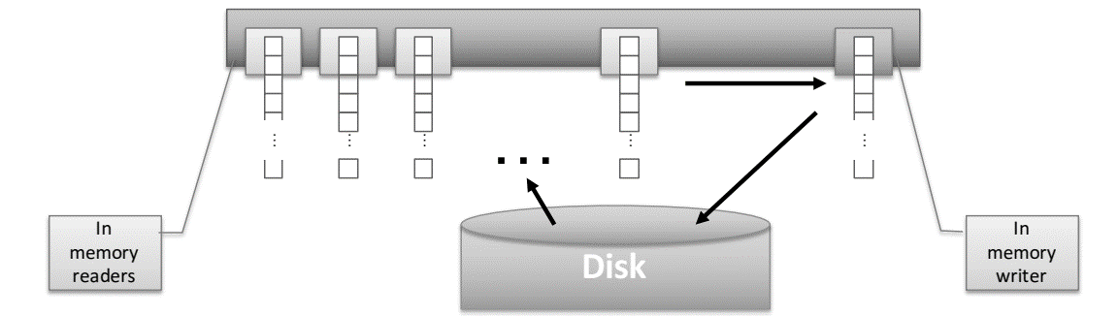

Slide 22
Remaining problem with sort-based algorithm
Our assumption was: we can keep the dictionary in memory.
We need the dictionary (which grows dynamically) to implement a term to termID mapping.
We could work with term, docID postings instead of termID, docID postings . . .
. . . but then intermediate files become very large. (We would end up with a scalable, but very slow index construction method.)

Slide 23
SPIMI: Single-pass in-memory indexing
Key idea 1: Generate separate dictionaries for each block – no need to maintain term-termID mapping across blocks.
Key idea 2: Don’t sort. Accumulate postings in postings lists as they occur.
With these two ideas we can generate a complete inverted index for each block.
These separate indexes can then be merged into one big index.

Slide 24
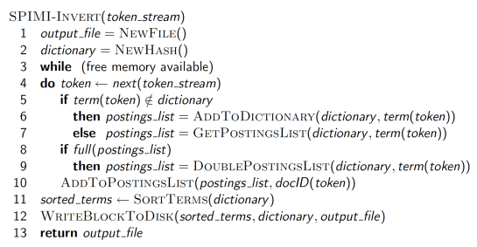
SPIMI-Invert
Merging of blocks is analogous to BSBI.

Slide 25
SPIMI in action
Input Token
Caeser D1
With D1
Brutus D1
Caeser D2
With D2
Brutus D3
With D3
Caeser D4
Noble D5
With D5
Dictionary
Brutus D1 D3
With D1 D2 D3 D4 D5
Noble D5
Caeser D1 D2 D4
Sorted Dictionary
Brutus D1 D3
Caeser D1 D2 D4
Noble D5
With D1 D2 D3 D4 D5

Slide 26
SPIMI: Compression
Compression makes SPIMI even more efficient.
Compression of terms
Compression of postings

Slide 27
Distributed Indexing
For web-scale indexing: must use a distributed computing cluster
Individual machines are fault-prone
Can unpredictably slow down or fail
How do we exploit such a pool of machines?

Slide 28
Google Data Centre
Google data centers mainly contain commodity machines
Data centers are distributed around the world
Estimate: a total of 2 million servers
Estimate: Google installs 100,000 servers each quarter
Based on expenditures of 200–250 million dollars per year
This would be 10% of the computing capacity of the world!?!

Slide 29
Google Data Centre
Consider a non-fault-tolerant system with 1000 nodes
Each node has 99.9% availability (probability to be up in a time unit), what is the availability of the system?
All of them should be simultaneously up
Answer: 37%
(p of staying up)# of server = (0.999)1000

Slide 30
Distributed Indexing
Maintain a master machine directing the indexing job – considered “safe”
Break up indexing into sets of (parallel) tasks
Master machine assigns each task to an idle machine from a pool.

Slide 31
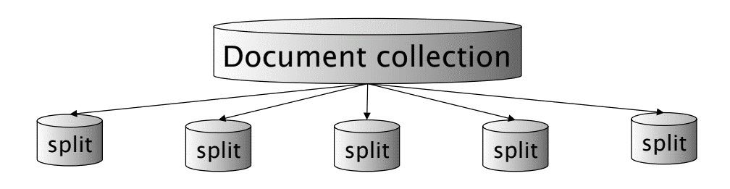
Parallel Task
We will use two sets of parallel tasks
Parsers
Inverters
Break the input document collection into splits
Each split is a subset of documents (corresponding to blocks in BSBI/SPIMI)

Slide 32
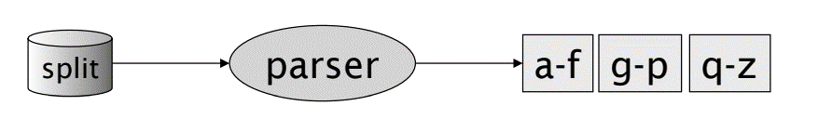
Parser
Master assigns a split to an idle parser machine
Parser reads a document at a time and emits (term, doc-id) pairs
Parser writes pairs into j partitions
Each partition is for a range of terms’ first letters
(e.g., a-f, g-p, q-z) – here j = 3.
Now to complete the index inversion …

Slide 33
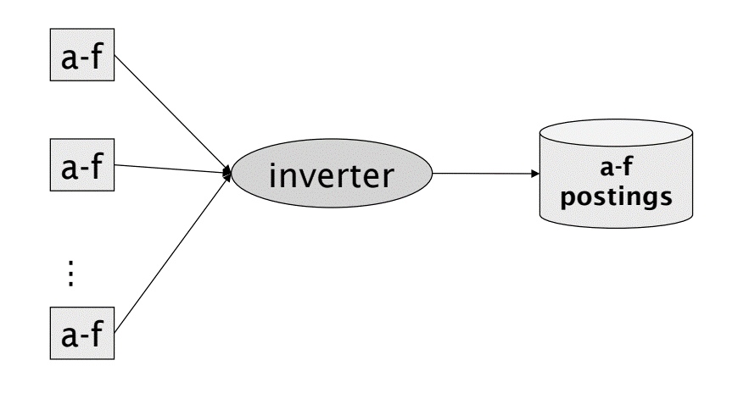
Inverter
An inverter collects all (term-id, doc-id) pairs (= postings) for one term-partition (from the different segments produced by the parsers)
Sorts and writes to postings lists.

Slide 34
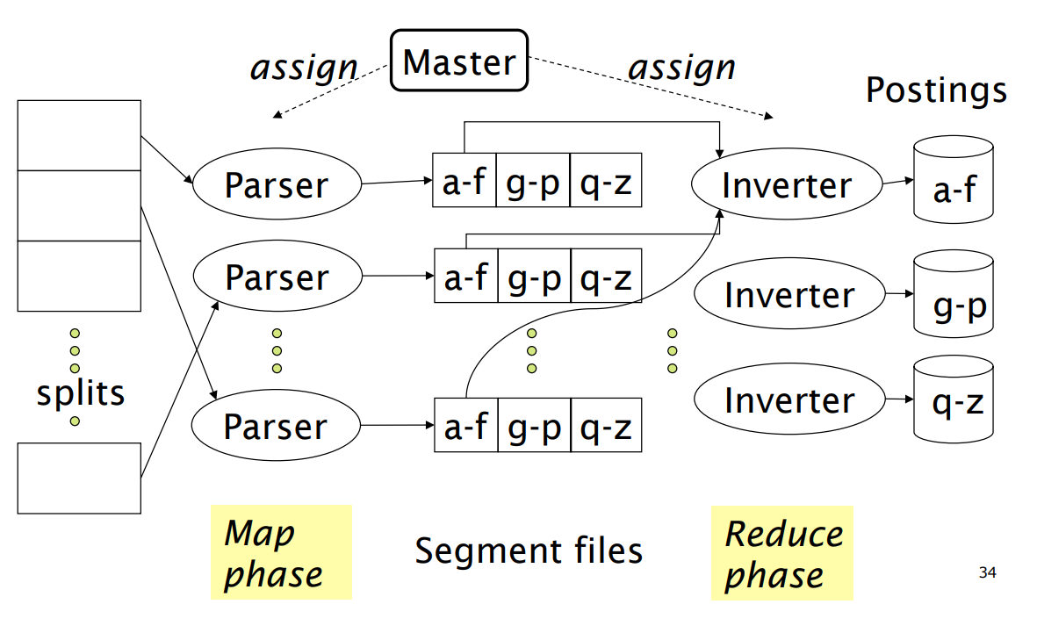
Data flow: MapReduce

Slide 35
Map Reduce
The index construction algorithm we just described is an instance of MapReduce
MapReduce (Dean and Ghemawat 2004) is a robust and conceptually simple framework for distributed computing …
… without having to write code for the distribution part
Solve large computing problems on cheap commodity machines or nodes that are built from standard parts (processor, memory, disk) as opposed to on a supercomputer with specialized hardware
They describe the Google indexing system (ca. 2002) as consisting of a number of phases, each implemented in MapReduce.

Slide 36
MapReduce
Index construction was just one phase
Another phase (not shown here): transforming a term-partitioned index into a document-partitioned index (for query processing)
Term-partitioned: one machine handles a subrange of terms
Document-partitioned: one machine handles a subrange of documents
As we will discuss in the web part of the course - most search engines use a document-partitioned index … better load balancing, etc.

Slide 37
Schema for index construction in MapReduce
Schema of map and reduce functions
map: input → list(k, v) reduce: (k,list(v)) → output
Instantiation of the schema for index construction
map: web collection → list(termID, docID)
reduce: (, , …) → (postings list1, postings list2, …)
Example for index construction
map: (d2 : "C died.", d1 : "C came, C c’ed.") → (<C,d2>,<died,d2>,<C,d1>,<came,d1>,<C,d1>,<C’ed,d1>
reduce: (<C,d2,d1,d1>,<died,d2>,<came,d1>,<C’ed,d1> → (<C,(d1:2,d2:1)>,<died,(d2:1)>,<came,(d1:1)>)

Slide 38
Dynamic Indexing
Up to now, we have assumed that collections are static
They rarely are:
Documents come in over time and need to be inserted
Documents are deleted and modified
This means that the dictionary and postings lists have to be modified:
Postings updates for terms already in dictionary
New terms added to dictionary

Slide 39
Simplest Approach
Maintain big main index
New docs go into small auxiliary index
Search across both, merge results
Deletions
Invalidation bit-vector for deleted docs
Filter docs output on a search result by this invalidation bit-vector
Periodically, re-index into one main index.

Slide 40
Issues with main and Auxiliary indexes
Problem of frequent merges – you touch stuff a lot
Poor performance during merge
Actually:
Merging of the auxiliary index into the main index is efficient if we keep a separate file for each postings list
Merge is the same as a simple append
But then we would need a lot of files – inefficient for the OS
Assumption : The index is one big file
In reality: use a scheme somewhere in between (e.g., split very large postings lists, collect postings lists of length 1 in one file etc.).

Slide 41
Logarithmic Merge
Maintain a series of indexes, each twice as large as the previous one
Keep smallest (Z0) in memory
Larger ones (I0, I1, …) on disk
If Z0 gets too big (> n), write to disk as I0
or merge with I0 (if I0 already exists) as Z1
Either write merge Z1 to disk as I1 (if no I1)
Or merge with I1 to form Z2
etc.

Slide 42
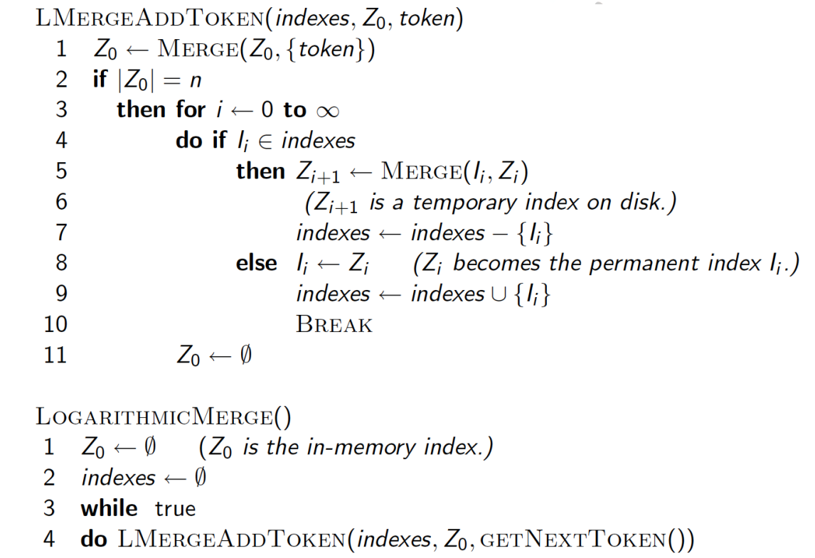

Slide 43
Logarithmic Merge
Auxiliary and main index: index construction time is O(T2) as each posting is touched in each merge
Logarithmic merge: Each posting is merged O(log T) times, so complexity is O(T log T)
So, logarithmic merge is much more efficient for index construction
But query processing now requires the merging of O(log T) indexes
Whereas it is O(1) if you just have a main and auxiliary index

Slide 44
Further Issues with Multiple Indexes
Collection-wide statistics are hard to maintain
E.g., when we spoke of spell-correction: which of several corrected alternatives do we present to the user?
We said, pick the one with the most hits
How do we maintain the top ones with multiple indexes and invalidation bit vectors?
One possibility: ignore everything but the main index for such ordering
Will see more such statistics used in results ranking.

Slide 45
Dynamic Indexing at Search Engine
All the large search engines now do dynamic indexing
Their indices have frequent incremental changes
News items, blogs, new topical web pages
Grillo, Crimea, …
But (sometimes/typically) they also periodically reconstruct the index from scratch
Query processing is then switched to the new index, and the old index is then deleted

Slide 46
Summary
Sort-based indexing
Naïve in-memory inversion
Blocked Sort-Based Indexing
Merge sort is effective for disk-based sorting (avoid seeks!)
Single-Pass In-Memory Indexing
No global dictionary
Generate separate dictionary for each block
Don’t sort postings
Accumulate postings in postings lists as they occur
Distributed indexing using MapReduce
Dynamic indexing: Multiple indices, logarithmic merge

Slide 47
Why Compression
Use less disk space
Saves a little money
Keep more stuff in memory
Increases speed
Increase speed of data transfer from disk to memory
[read compressed data | decompress] is faster than [read uncompressed data]
Premise: Decompression algorithms are fast
True of the decompression algorithms we use

Slide 48
Why Compression for Inverted Index
Dictionary
Make it small enough to keep in main memory
Make it so small that you can keep some postings lists in main memory too
Postings file(s)
Reduce disk space needed
Decrease time needed to read postings lists from disk
Large search engines keep a significant part of the postings in memory.
Compression lets you keep more in memory
We will devise various IR-specific compression schemes

Slide 49
Reuters RCV1 Statistics

Slide 50
Lossless vs. lossy compression
Lossless compression: All information is preserved.
What we mostly do in IR.
Lossy compression: Discard some information
Several of the preprocessing steps can be viewed as lossy compression: case folding, stop words, stemming, number elimination.

Slide 51
Vocabulary size vs. collection size
How big is the term vocabulary?
That is, how many distinct words are there?
Can we assume an upper bound?
Not really: At least 7020 = 1037 different words of length 20
In practice, the vocabulary will keep growing with the collection size
Especially with Unicode

Slide 52
Vocabulary size vs. collection size
Heaps’ law: M = kTb
M is the size of the vocabulary, T is the number of tokens in the collection
Typical values: 30 ≤ k ≤ 100 and b ≈ 0.5
In a log-log plot of vocabulary size M vs. T, Heaps’ law predicts a line with slope about ½
It is the simplest possible (linear) relationship between the two in log-log space
log M = log k + b log T
An empirical finding (“empirical law”)

Slide 53
Heaps’ Law
For RCV1, the dashed line
log10M = 0.49 log10T + 1.64 is the best least squares fit.
Thus, M = 101.64T0.49 so k = 101.64 ≈ 44 and b = 0.49.
Good empirical fit for Reuters RCV1 !
For first 1,000,020 tokens, law predicts 38,323 terms; actually, 38,365 terms

Slide 54
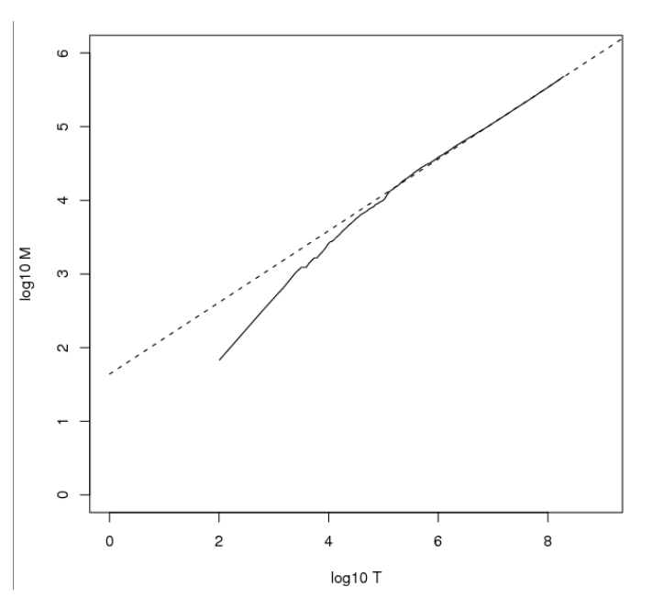
Heaps’ Law

Slide 55
Zipf’s law
Heaps’ law gives the vocabulary size in collections.
We also study the relative frequencies of terms.
In natural language, there are a few very frequent terms and very many very rare terms.
Zipf’s law: The i th most frequent term has frequency proportional to 1/i .
cfi ∝ 1/i = K/i where K is a normalizing constant
cfi is collection frequency: the number of occurrences of the term ti in the collection.

Slide 56
Zipf consequences
If the most frequent term (the) occurs cf1 times
then the second most frequent term (of) occurs cf1/2 times
the third most frequent term (and) occurs cf1/3 times …
Equivalent: cfi = K/i where K is a normalizing factor, so
log cfi = log K - log i
Linear relationship between log cfi and log i
Another power law relationship

Slide 57
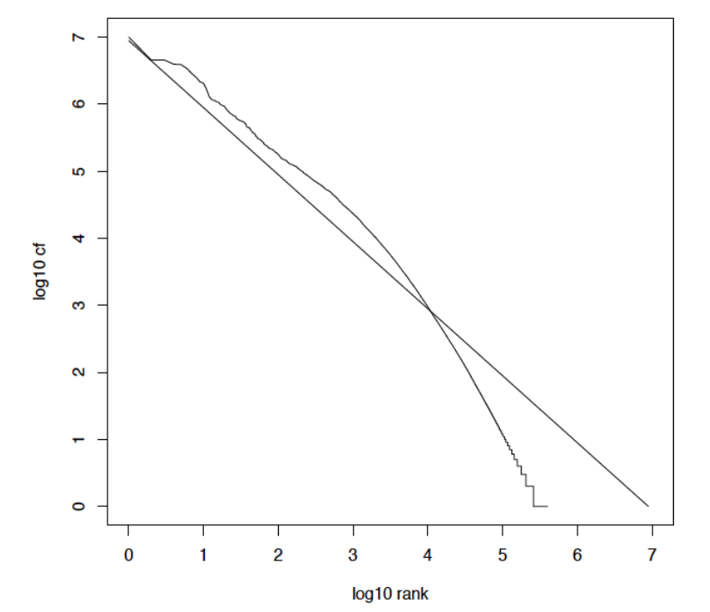
Zipf’s law for Reuters RCV1

Slide 58
Compression
Now, we will consider compressing the space for the dictionary and postings. We’ll do:
Basic Boolean index only
No study of positional indexes, etc.
But these ideas can be extended
We will consider compression schemes

Slide 59
DICTIONARY COMPRESSION
Why compress the dictionary?
Search begins with the dictionary
We want to keep it in memory
Memory footprint competition with other applications
Embedded/mobile devices may have very little memory
Even if the dictionary isn’t in memory, we want it to be small for a fast search startup time
So, compressing the dictionary is important

Slide 60
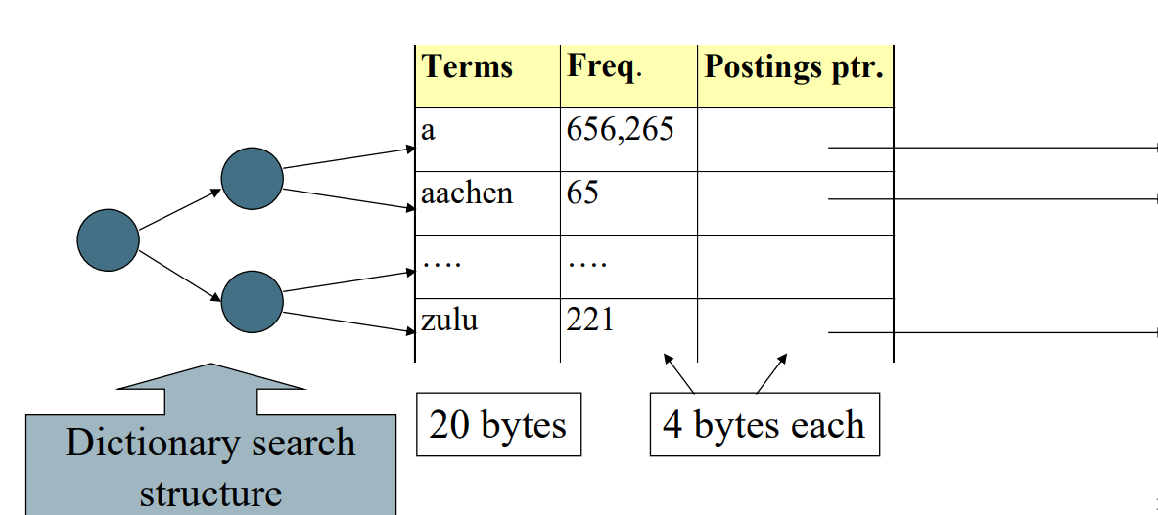
Dictionary storage – naïve version
Array of fixed-width entries
~400,000 terms; 28 bytes/term = 11.2 MB

Slide 61
Fixed-width terms are wasteful
Most of the bytes in the Term column are wasted – we allot 20 bytes for 1 letter terms.
And we still can’t handle supercalifragilisticexpialidocious or hydrochlorofluorocarbons.
Written English averages ~4.5 characters/word.
Avg. dictionary word in English: ~8 characters
How do we use ~8 characters per dictionary term?
Short words dominate token counts but not type average.

Slide 62
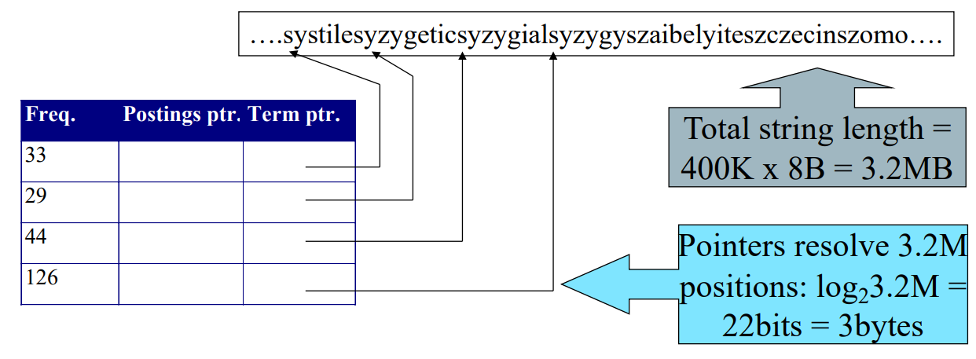
Compressing the term list: Dictionary-as-a-String
Store dictionary as a (long) string of characters:
Pointer to next word shows end of current word
Hope to save up to 60% of dictionary space

Slide 63
Space for dictionary as a string
4 bytes per term for Freq.
4 bytes per term for pointer to Postings.
3 bytes per term pointer
Avg. 8 bytes per term in term string
400K terms x 19 = 7.6 MB (against 11.2MB for fixed width)

Slide 64
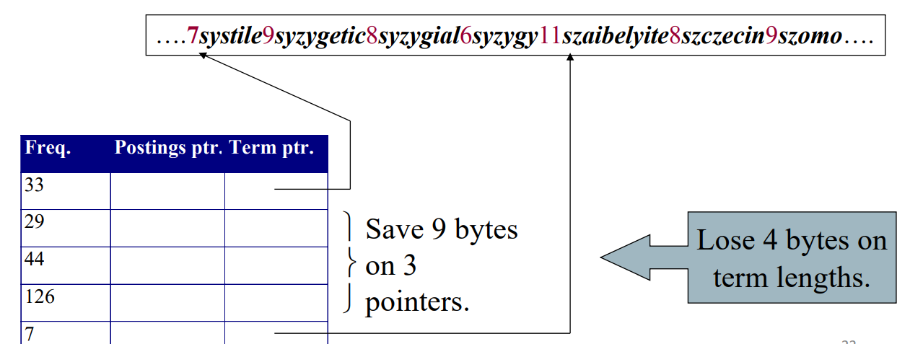
Blocking
Store pointers to every kth term string.
Example below: k=4.
Need to store term lengths (1 extra byte)

Slide 65
Blocking Net Gains
Example for block size k = 4
Where we used 3 bytes/pointer without blocking
3 x 4 = 12 bytes, now we use 3 + 4 = 7 bytes.
Shaved another ~0.5MB. This reduces the size of the dictionary from 7.6 MB to 7.1 MB. We can save more with larger k.
400K x 3B=1.2 MB
100K x 3B=0.3 MB
0.9 MB storage
But add 400k i.e. 0.4MB extra space
So total saving =0.3+0.4=0.7,➔1.2-0.7=0.5 MB
Question: Why not go with larger k?

Slide 66
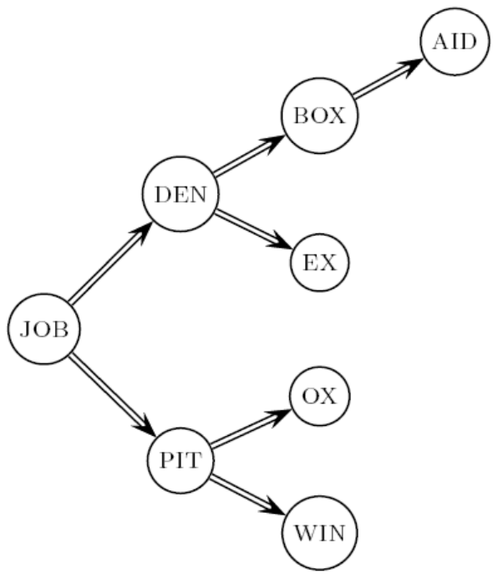
Dictionary search without blocking
Assuming each dictionary term equally likely in query (not really so in practice!), average number of comparisons = (1+2·2+4·3+4)/8 ~2.6

Slide 67
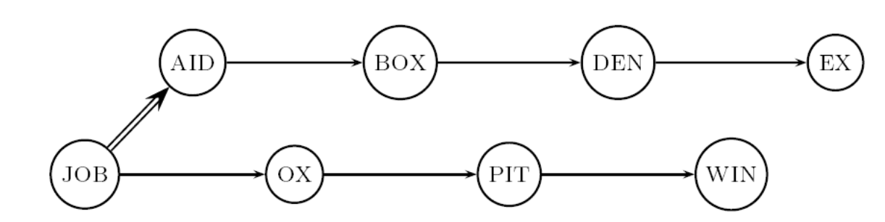
Dictionary search with blocking
Binary search down to 4-term block;
Then linear search through terms in block.
Blocks of 4 (binary tree), avg. = (1+2·2+2·3+2·4+5)/8 = 3 compares

Slide 68
Exercises
Estimate the space usage (and savings compared to 7.6 MB) with blocking, for block sizes of k = 4, 8 and 16.
Estimate the impact on search performance (and slowdown compared to k=1) with blocking, for block sizes of k = 4, 8 and 16.

Slide 69
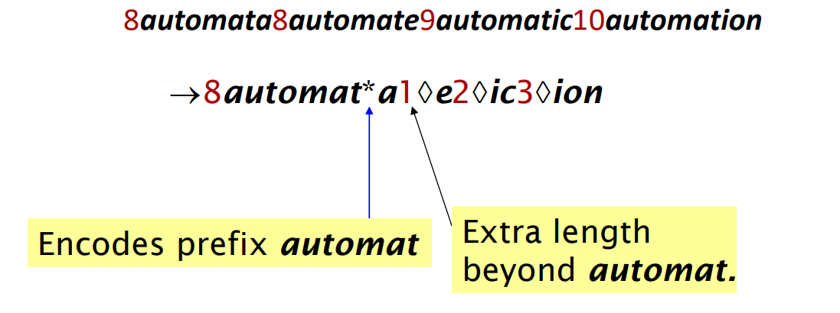
Front coding
Front-coding:
Sorted words commonly have long common prefix – store differences only
(for last k-1 in a block of k)

Slide 70
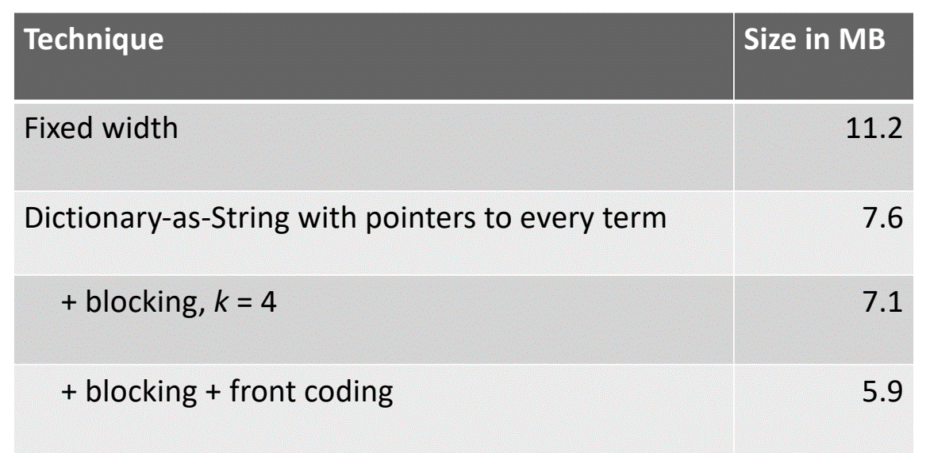
RCV1 dictionary compression summary

Slide 71
POSTINGS COMPRESSION
The postings file is much larger than the dictionary, factor of at least 10, often over 100 times larger
Key desideratum: store each posting compactly.
A posting for our purposes is a docID.
For Reuters (800,000 documents), we would use 32 bits per docID when using 4-byte integers.
Alternatively, we can use log2 800,000 ≈ 20 bits per docID.
Our goal: use far fewer than 20 bits per docID.

Slide 72
Postings: two conflicting forces
A term like arachnocentric occurs in maybe one doc out of a million – we would like to store this posting using log2 1M ≈ 20 bits.
A term like ‘the’ occurs in virtually every doc, so 20 bits/posting ≈ 2MB is too expensive.
Prefer 0/1 bitmap vector in this case (≈100K)

Slide 73
Gap encoding of postings file entries
We store the list of docs containing a term in increasing order of docID.
computer: 33,47,154,159,202 …
Consequence: it suffices to store gaps.
33,14,107,5,43 …
Hope: most gaps can be encoded/stored with far fewer than 20 bits.
Especially for common words

Slide 74
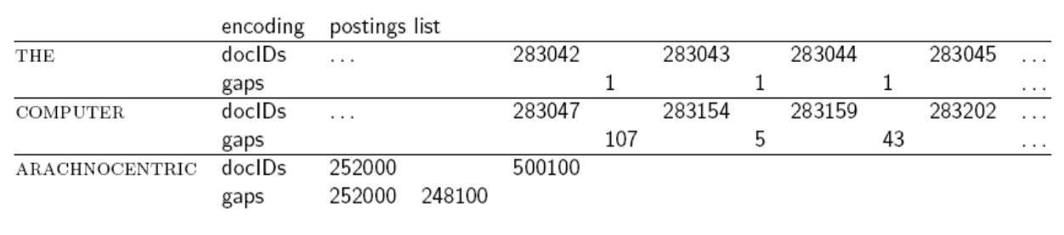
Three postings entries

Slide 75
Variable length encoding
Aim:
For arachnocentric, we will use ~20 bits/gap entry.
For the, we will use ~1 bit/gap entry.
If the average gap for a term is G, we want to use ~log2G bits/gap entry.
Key challenge: encode every integer (gap) with about as few bits as needed for that integer.
This requires a variable length encoding
Variable length codes achieve this by using short codes for small numbers

Slide 76
Variable Byte (VB) codes
For a gap value G, we want to use close to the fewest bytes needed to hold log2 G bits
Begin with one byte to store G and dedicate 1 bit in it to be a continuation bit c
If G ≤127, binary-encode it in the 7 available bits and set c =1
Else encode G’s lower-order 7 bits and then use additional bytes to encode the higher order bits using the same algorithm
At the end set the continuation bit of the last byte to 1 (c =1) – and for the other bytes c = 0.

Slide 77
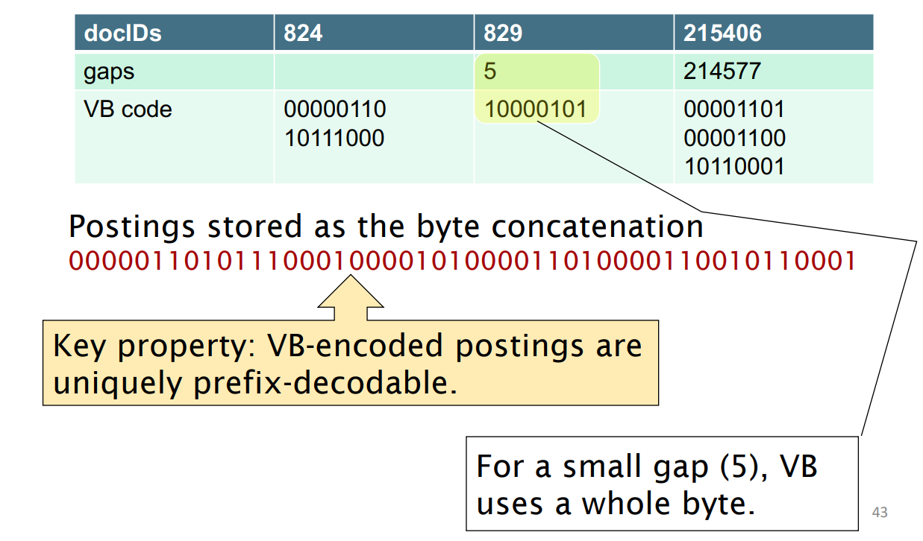
Example

Slide 78
Unary code
Represent n as n 1s with a final 0.
Unary code for 3 is 1110.
Unary code for 40 is 11111111111111111111111111111111111111110 .
Unary code for 80 is: 11111111111111111111111111111111111111111111 1111111111111111111111111111111111110
This doesn’t look promising, but….
Optimal if P(n) = 2–n
We can use it as part of our solution

Slide 79
Gamma codes
We can compress better with bit-level codes
The Gamma code is the best known of these.
Represent a gap G as a pair length and offset
offset is G in binary, with the leading bit cut off
For example 13 → 1101 → 101
length is the length of offset
For 13 (offset 101), this is 3.
We encode length with unary code: 1110.
Gamma code of 13 is the concatenation of length and offset: 1110101

Slide 80
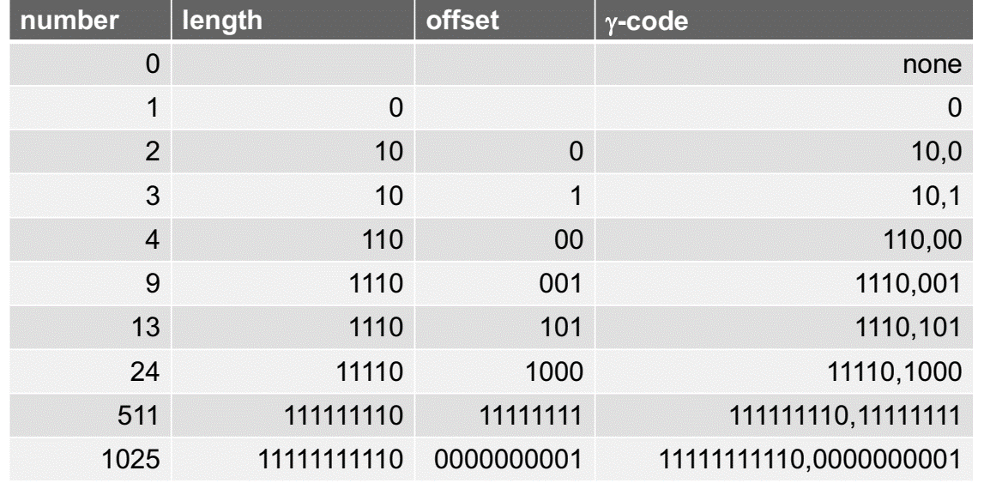
Gamma code examples

Slide 81
Gamma code properties
G is encoded using 2 ⌊ log G ⌋ + 1 bits
Length of offset is ⌊ log G⌋ bits
Length of length is ⌊ log G ⌋ + 1 bits
Almost within a factor of 2 of best possible, log2 G
Gamma code is uniquely prefix-decodable.

Slide 82
Gamma seldom used in practice
Machines have word boundaries – 8, 16, 32, 64 bits
Operations that cross word boundaries are slower
Compressing and manipulating at the granularity of bits can be too slow
All modern practice is to use byte or word aligned codes
Variable byte encoding is a faster, conceptually simpler compression scheme, with decent compression

Slide 83
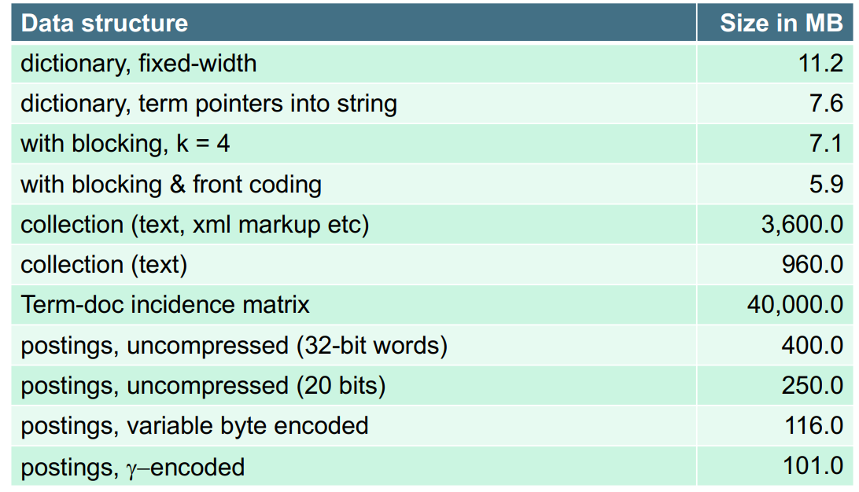
RCV1 compression

Slide 84
Index compression summary
We can now create an index for highly efficient Boolean retrieval that is very space efficient
Only 4% of the total size of the collection
Only 10-15% of the total size of the text in the collection
We’ve ignored positional information
Hence, space savings are less for indexes used in practice
But techniques substantially the same

Slide 85
Three postings entries

Slide 86
Gamma code examples

Slide 87
Compute variable byte and γ codes for the postings list <777, 17743, 294068, 31251336>. Use gaps instead of docIDs where possible. Write binary codes in 8-bit blocks

Slide 88
Blocking Net Gains
Example for block size k = 4
Where we used 3 bytes/pointer without blocking
3 x 4 = 12 bytes, now we use 3 + 4 = 7 bytes.
Shaved another ~0.5MB. This reduces the size of the dictionary from 7.6 MB to 7.1 MB. We can save more with larger k.
400K x 3B=1.2 MB
100K x 3B=0.3 MB
0.9 MB storage
But add 400k i.e. 0.4MB extra space
So total saving =0.3+0.4=0.7,➔1.2-0.7=0.5 MB
Question: Why not go with larger k?

Slide 89
Dictionary search without blocking
Assuming each dictionary term equally likely in query (not really so in practice!), average number of comparisons = (1+2·2+4·3+4)/8 ~2.6

Slide 90
Dictionary search with blocking
Binary search down to 4-term block;
Then linear search through terms in block.
Blocks of 4 (binary tree), avg. = (1+2·2+2·3+2·4+5)/8 = 3 compares

Slide 91
Estimate the space usage (and savings compared to 7.6 MB) with blocking, for block sizes of k = 4, 8 and 16.
Estimate the impact on search performance (and slowdown compared to k=1) with blocking, for block sizes of k = 4, 8 and 16.

Slide 92
Example for block size k = 8
Where we used 3 bytes/pointer without blocking
3 x (8-1) = 21 bytes, now we use 3 + 7 = 10 bytes.
We can save more with larger k.
400K x 3B=1.2 MB
50K x 3B=0.15 MB
0.9 MB storage
But add 400k i.e. 0.4MB extra space
So total saving =0.15+0.4=0.55,➔1.2-0.55=0.65 MB
7.6-0.65=6.95 MB

Slide 93
Example for block size k = 16
Where we used 3 bytes/pointer without blocking
3 x (16-1) = 45 bytes, now we use 3 + 15 = 15 bytes.
We can save more with larger k.
400K x 3B=1.2 MB
25K x 3B=0.075 MB
0.9 MB storage
But add 400k i.e. 0.4MB extra space
So total saving =0.075+0.4=0.475,➔1.2-0.475=0.625 MB
7.6-0.625=6.875 MB

Slide 94
Dictionary search without blocking
Assuming each dictionary term equally likely in query (not really so in practice!), average number of comparisons = (1+2·2+4·3+4.8+5.16+6.32)/8 ~2.6

Slide 95
Dictionary search with blocking
Binary search down to 4-term block;
Then linear search through terms in block.
Blocks of 4 (binary tree), avg. = (1+2·2+2·3+2·4+2.5+2.6)/8 = 3 compares

Slide 96
Compute the variable byte codes for the numbers

Slide 97
Three postings entries
Compute the variable byte codes for the numbers
283042: 000100010010001110100010 , 1 : 10000001, 1 : 10000001, 1: 10000001 , 283047: 010011110100011010001000, 107: 01101011, 5 : 10000101, 43 : 10101011 ,252000:000011110011000011100000, 248100 : 000011110001001010100100 ,

Slide 98
0 : 10000000 , 2:10000010 , 3: 10000011 , 4 : 10000100 , 9 : 10001001 , 13 : 10001101 , 24 : 10011000 , 511 : 0000001111111111 , 1025 : 0000100010000001

Slide 99
Practice Question
Compute variable byte and γ codes for the postings list <777, 17743, 294068, 31251336>. Use gaps instead of docIDs where possible. Write binary codes in 8- bit blocks.

Slide 100
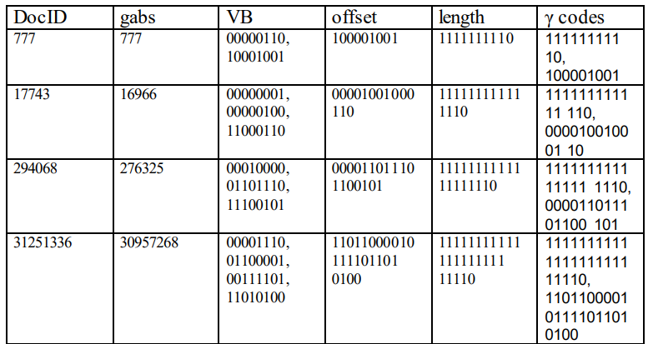

Slide 101
Consider a postings list: <4, 15, 62, 63, 265, 268, 270, 500> with the corresponding list of document gaps: <4, 11, 47, 1, 202, 3, 2, 230> Assume that the length of the postings list is stored separately, so the system knows when a postings list is complete. We are going to contrast the size and speed tradeoffs of using variable byte encoding with gamma encoding. (a) Encode the document gaps using variable byte encoding. (b) Encode the document gaps using gamma encoding.

Slide 102
Compute variable byte and Î³ codes for the postings list 7, 17, 29, 31, 45, 90, 110. Use gaps instead of docIDs where possible. Write binary codes in 8-bit blocks.
1. Variable byte code: - 7: 00000111 - 17: 00010001 - 29: 00011101 - 31: 00011111 - 45: 00101101 - 90: 01011010 - 110: 01101110
γ code: - 7: 0000111 - 17: 0010001 - 29: 0011101 - 31: 0011111 - 45: 0101101 - 90: 1011010 - 110: 1101110

Slide 103
Practice Question
From the following sequence of γ-coded gaps, reconstruct first the gap sequence and then the postings sequence: 1110001110101011111101101111011.

Slide 104
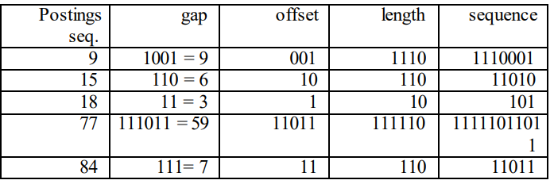
From the following sequence of γ-coded gaps, reconstruct first the gap sequence and then the postings sequence: 1110001110101011111101101111011.

Slide 105
Suppose the vocabulary for your inverted index consists of the following 6 terms:
elite
elope
ellipse
eloquent
eligible
elongate
Assume that the dictionary data structure used for this index stores the sorted list of terms using dictionary-as-a-string storage with front coding and a block size of 3. Show the resulting storage of the above vocabulary of 6 terms. Use the special symbols * and ♦ is used in the discussion on front coding

